Slide 1

Comparative Analysis of Various ML
Algorithms To Predict Diabetes Mellitus
Team Members
P.Sneha (14071A05G2)
S.Monika purna (14071A05G7)
P.Sai Sharanya (14071A05F8)
4) P.Pravallika (14071A05F7)
Project Guide
Mr. P.Venkateswara Rao,
Assistant Professor, Vnrvjiet.

Slide 2

CONTENTS
Abstract
Introduction
Existing System
Proposed System
Software and Hardware Requirements
UML Architecture
Methodology
Conclusion and future scope
References

Slide 3
Abstract
Health care data are often huge, complex and heterogeneous because it contains different variable types, missing values, null values and it may contain some noisy data. Now a days knowledge from such data set is a necessity. Machine learning algorithms can be utilized to
extract knowledge by constructing models from health care data such as diabetic patient data set.

Slide 4

In the research , We are going to pre-process the data. The pre-process of data includes removal
of noisy data, duplicate data, missing values and null values. The pre-processed data is given to
three different machine learning algorithms such as Decision tree, Support vector machine
(SVM), Naive Bayes algorithms. SVM algorithm achieved the best performance in predicting
the diabetes data set with accurate results compared to other classifier algorithms.

Slide 5
Introduction
Diabetes Mellitus is a chronic disease for which there is no known cure except in very specific situations management concentrates on keeping blood sugar levels as close to normal as possible .
The purpose of ML algorithms is to extract useful information from large databases

Slide 6
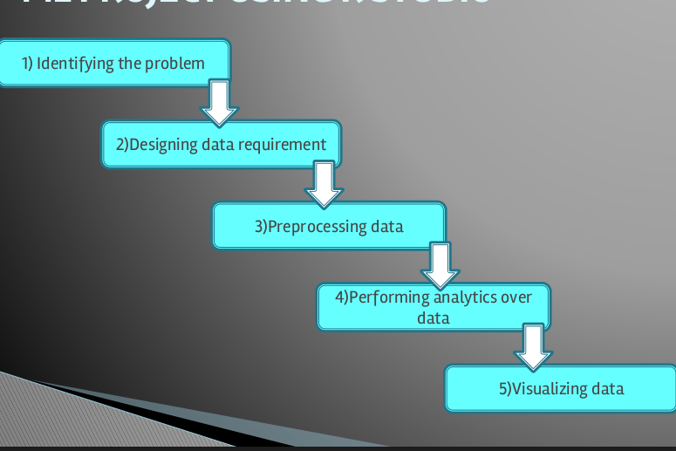
Process Flow

Slide 7
Existing System
1)Traditional Process of Predicting Diabetes is that patients need to visit a diagnostic centre, consult their doctor, and sit tight for a day or more to get their reports.
Moreover, every time they want to get their diagnosis report, they have to waste their money in vain.
2)The analysis of data is done by human intervention which may not give accurate results for large data.
3)To analyse any data which is more than 30GB takes huge amount of time for data pre-processing and data analysing.

Slide 8
Proposed System
1)The progressive system analyses the data using Machine Learning Algorithms without human intervention.
2)We collect the data and then pre-process it by using pre-processing techniques.
3)The aim of this research is to develop a system which can predict the diabetic risk level of a patient with a higher accuracy.

Slide 9
Software & Hardware
Requirements
Hardware Requirements:
Processor - Intel Pentium IV and above
RAM – 1GB and above
Hard disk - 100 GB Minimum
Processor Speed - 2.4 GHz
Software Requirements:
Operating System - Windows XP and above
R programming
R Studio (tool)

Slide 10

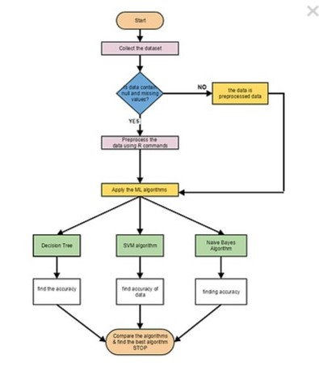
Flow Chart

Slide 11
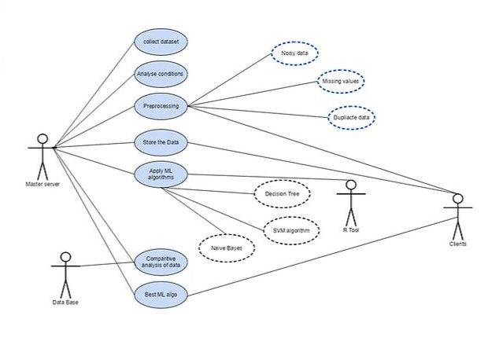
UML Architecture
Use Case Diagram

Slide 12
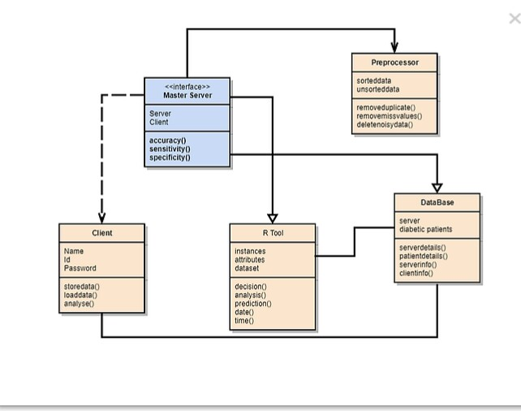
Class Diagram

Slide 13
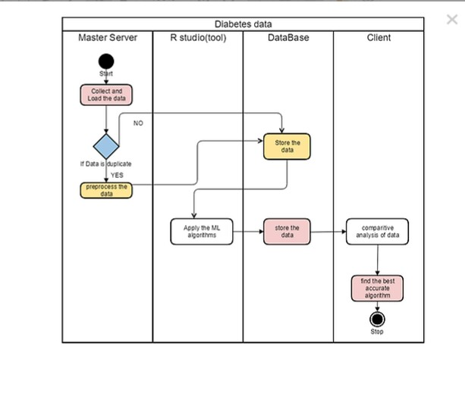
Activity Diagram

Slide 14
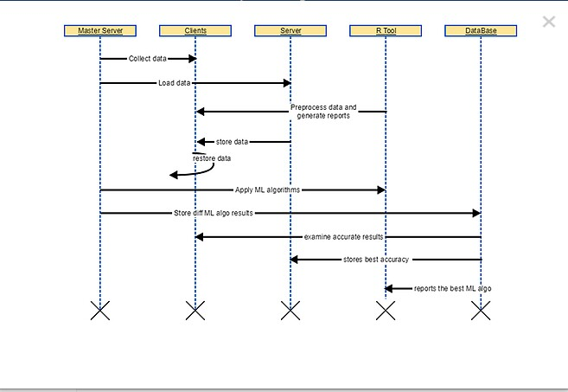
Sequence Diagram

Slide 15

Quick Outline
Our project consists of mainly 4 parts:
Pre-processing
->removing Duplicate ,Null and Missing values for dataset
Applying various ML algorithms
Checking accuracy among them
Finally finding the best ML algorithm

Slide 16
Pre-processing
Data preprocessing is a data mining technique that involves transforming raw data into an understandable format. Real-world data is often incomplete, inconsistent, and/or lacking in certain behaviors or trends, and is likely to contain many errors. Data preprocessing is a proven method of resolving such issues.

Slide 17

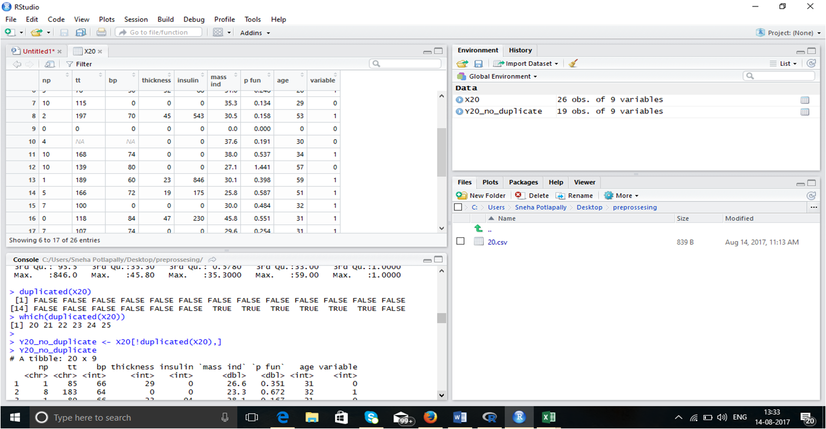
Pre-processed data
In R studio

Slide 18
Methodology
The algorithms used in this project are:
1)Decision Tree Algorithm
2)Naive Bayes
3)Support Vector Machine

Slide 19
DECISION TREE:
Decision-Tree is a tree structure which has the form of a flowchart.
It can be used as a method for classification and prediction with a representation using nodes and internodes.
Root and internal nodes are the test cases.
Leaf nodes considered as class variables. In order to classify a new item, it creates a decision tree based on the attribute values of the available training data set.

Slide 20

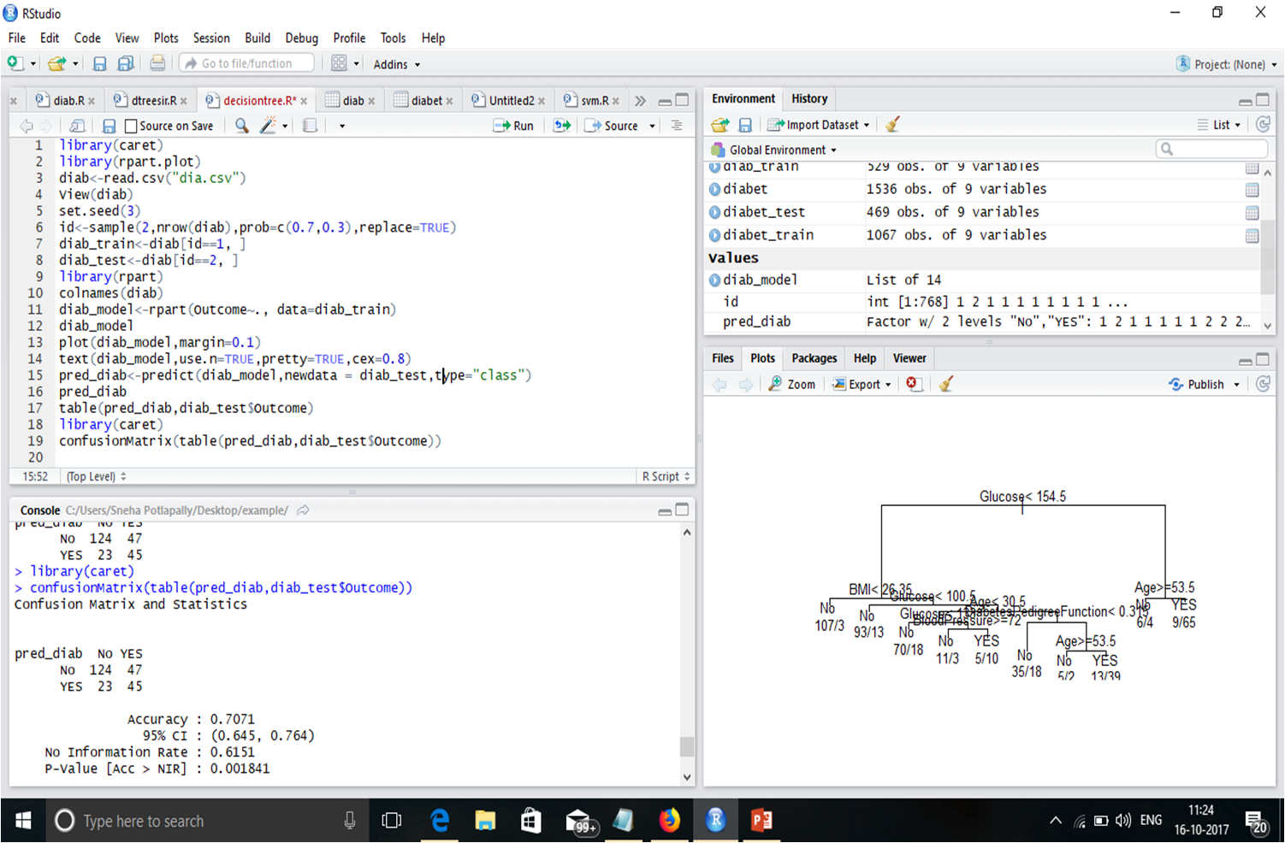
Decision tree Applied data

Slide 21
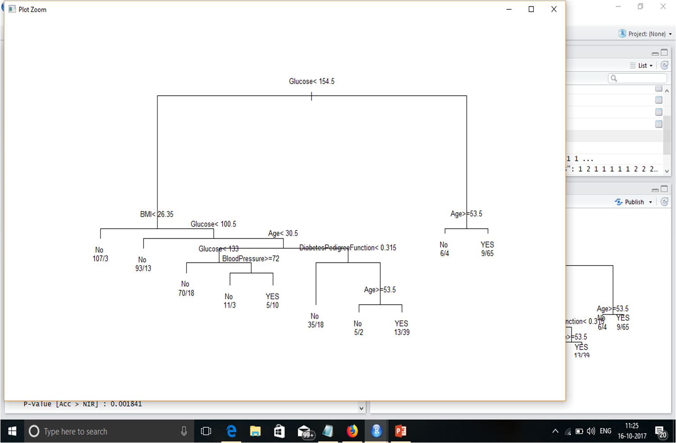
Output Decision tree

Slide 22
NAIVE BAYES:
This is based on Bayes rule of conditional probability.
It uses all the attributes contained in the data and analyzes them individually as though they are equally important and independent of each other.
The build process for Naive Bayes is parallelized.

Slide 23

SUPPORT VECTOR MACHINES:
In machine learning, support vector machines are supervised learning models with associated learning algorithms that analyze data used for classification and regression analysis

Slide 24
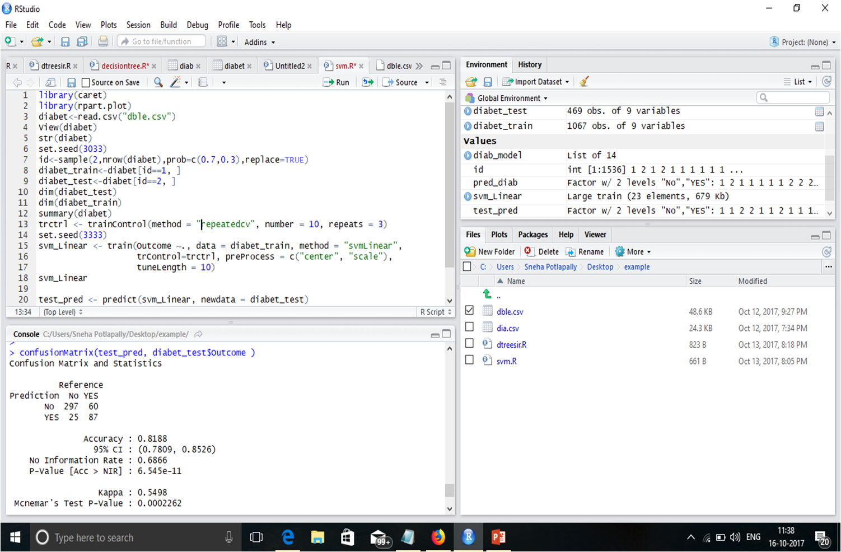
SVM Applied Data set

Slide 25

Decision Tree Output (768 instances)
 | Entropy | Information Gain | Gini Index
Accuracy | 0.7071 | 0.6987 | 0.6987
Sensitivity | 0.8435 | 0.9388 | 0.9388
Specificity | 0.4891 | 0.3152 | 0.3152
Prevalence | 0.5188 | 0.6151 | 0.6151

Slide 26
Decision Tree Output(1536 instances)
 | Entropy | Information Gain | Gini Index
Accuracy | 0.7744 | 0.7983 | 0.7831
Sensitivity | 0.8541 | 0.8541 | 0.8683
Specificity | 0.6580 | 0.7111 | 0.6500
Prevalence | 0.6095 | 0.6095 | 0.6095

Slide 27
OUTPUT(768 instances)
 | Decision Tree | SVM | Naive Bayes
Accuracy | 0.7071 | 0.8253 | 0.7604
Sensitivity | 0.8435 | 0.9286 | 0.8423
Specificity | 0.4891 | 0.6133 | 0.6067
Prevalence | 0.6151 | 0.6725 | 0.6523

Slide 28
OUTPUT(1536 instances)
 | Decision Tree | SVM | Naive Bayes
Accuracy | 0.7744 | 0.8188 | 0.7604
Sensitivity | 0.8541 | 0.9244 | 0.8423
Specificity | 0.6580 | 0.5918 | 0.6067
Prevalence | 0.6095 | 0.6866 | 0.6523

Slide 29
Conclusion
Among all the applied ML algorithms Support Vector Machine Algorithm(SVM) gives the best accuracy with 82% and Decision tree gives the accuracy with 70% and Naïve Bayes gives the accuracy with 76%.

Slide 30
Future scope
Though SVM algorithm gives the best result among the applied algorithms it cannot give 100% accuracy. So, we are trying to predict best accuracy with more than 98% by applying iteratively reweighted least squares (IRLS) and Quasi-Newton method with Mathematical Formulation.

Slide 31
References
Pre-Processing: https://www.tutorialspoint.com/r/
Decision Tree Algorithm : http://dataaspirant.com/2017/02/03/decision-tree classifier-implementation-in-r/\
Support Vector Algorithm : http://dataaspirant.com/2017/01/19/support-vector-machine-classifier-implementation-r-caret-package/
Naïve Bayes Algorithm: https://www.r-bloggers.com/naive-bayes-classification-in-r-part-2/

Slide 32

Thank you

